Slide 1
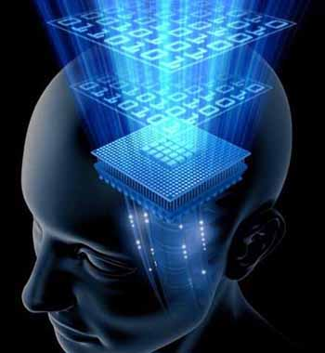
Transfer Entropy
„Information Transfer in Neurological Systems“
Immo Weber

Slide 2
Outline
Information Theory
Shannon Information
Shannon Entropy
Conditional Entropy
Mutual Information
Conditional Mutual Information
Wiener Causality
Transfer Entropy
State Space
Goals
Results
Outlook

Slide 3
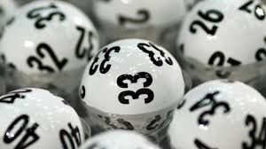
Information Theory
Exp.: „6 of 49“ - - - - - - p=1 (1:13983816)
p

Slide 4
Information Theory
Exp.: „6 of 49“ 5 - - - - - p=1:1712300
p
5

Slide 5
Information Theory
Exp.: „6 of 49“ 5 7 - - - - p=1:178360
Information gain = reduction of uncertainty!
p
7

Slide 6
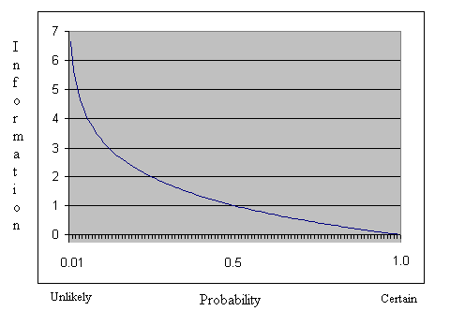
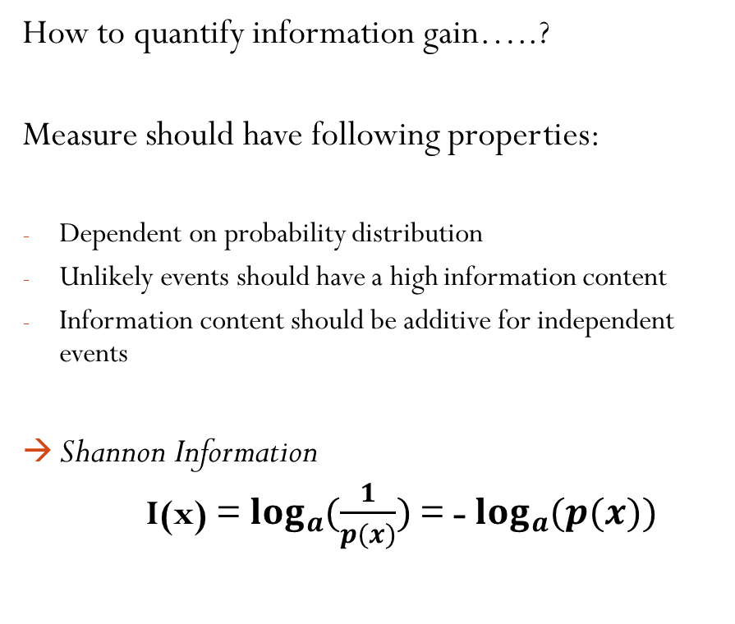
Information Theory
How to quantify information gain…..?
Measure should have following properties:
Dependent on probability distribution
Unlikely events should have a high information content
Information content should be additive for independent events
Shannon Information
I(x) =$\log_{a}{(\frac{1}{p(x)}})$ = -$\log_{a}{(p(x))}$

Slide 7
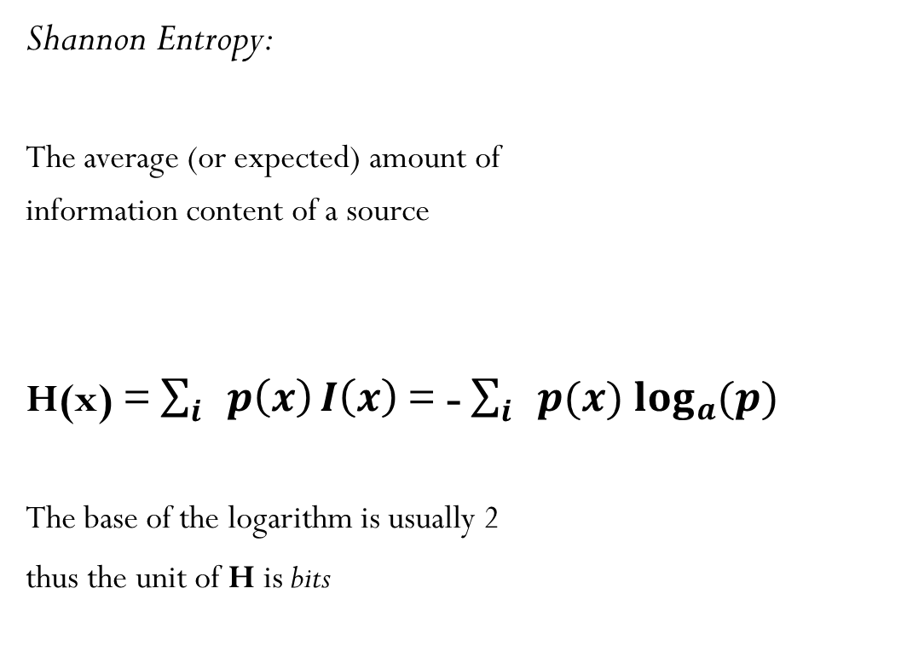
Information Theory
Shannon Entropy:
The average (or expected) amount of
information content of a source
H(x) = $\sum_{i}{p\left(x\right)}I\left(x\right)$= -$\sum_{i}{p(x)}\log_{a}{(p)}$
The base of the logarithm is usually 2
thus the unit of H is bits

Slide 8
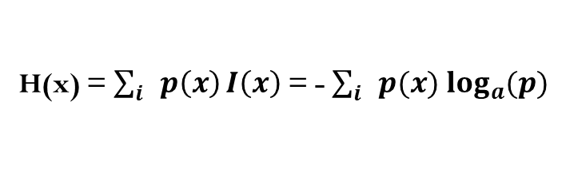

Information Theory
I(x) =$\log_{a}{(\frac{1}{p(x)}})$ = -$\log_{a}{(p(x))}$
Example:
This is a sentence.
H(x) = 2,8740 bits
H(x) = $\sum_{i}{p\left(x\right)}I\left(x\right)$= -$\sum_{i}{p(x)}\log_{a}{(p)}$
Letter | a | c | e | h | i | n | s | t
P(x) | 1/15 | 1/15 | 3/15 | 1/15 | 2/15 | 2/15 | 3/15 | 2/15
I(x) | 3,91 | 3,91 | 2,32 | 3,91 | 2,91 | 2,91 | 2,32 | 2,91

Slide 9

Information Theory
Conditional Entropy:
The average amount of uncertainty that
remains about an event X given the outcome of an event Y
H(X|Y) = $\sum{P\left(Y=y\right)H(X|Y=y)}$
5 - - - - -
5

Slide 10
Information Theory
Mutual Information:
The difference of the total average information
in one of the variables and the average information
that is unique to that variable:
X 0001011110000
Y 0110011001011
X
MI
Y

Slide 11
Information Theory
Mutual Information:
The difference of the total average information
in one of the variables and the average information
that is unique to that variable:
MI(X;Y) = H(X) - H(X|Y) = H(Y) - H(Y|X)
MI represents the information shared between
X and Y and is thus symmetric.
X 0001011110000
Y 0110011001011
X
MI
Y

Slide 12
Information Theory
Conditional Mutual Information:
By conditioning MI on a third variable
Z one gets the Conditional Mutual Information:
I(X;Y|Z) = H(X|Z) – H(X|Y,Z)
Y
xor
X
Z
 | Y =True | Y=False
Z=True | X=False | X=True
Z=False | X=True | X=False

Slide 13
Information Theory
Conditional Mutual Information:
By conditioning MI on a third variable
Z one gets the Conditional Mutual Information:
I(X;Y|Z) = H(X|Z) – H(X|Y,Z)
Y
xor
X
Z
 | Y =True | Y=False
Z=True | X=False | X=True
Z=False | X=True | X=False

Slide 14
Information Theory
Conditional Mutual Information:
By conditioning MI on a third variable
Z one gets the Conditional Mutual Information:
I(X;Y|Z) = H(X|Z) – H(X|Y,Z)
Y
xor
X
Z
 | Y =True | Y=False
Z=True | X=False | X=True
Z=False | X=True | X=False
X
MI
Y
Z

Slide 15
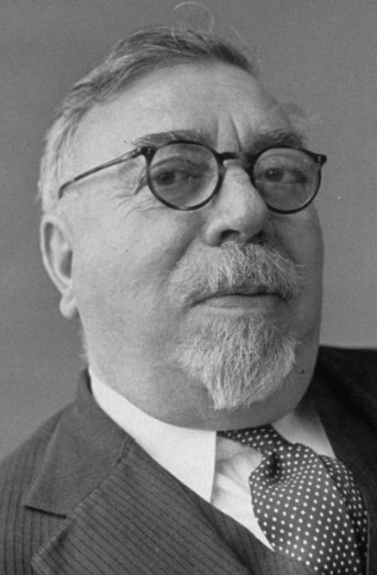
„Causality“
Wiener‘s Principle of Causality
A signal X is Wiener causal to a signal Y, if using past information of X leads to better predictions of Y than using only past information of Y.

Slide 16

Transfer Entropy
Wiener‘s Principle from the perspective of Information Theory:
How much additional information does the past state of process X contain about the future observation of a value of Y given that we already know the past state of Y?
$$TE\left(X→Y\right)=I\left(X^{−},Y^{+} | Y^{−}\right)$$
(Schreiber, 2000)

Slide 17
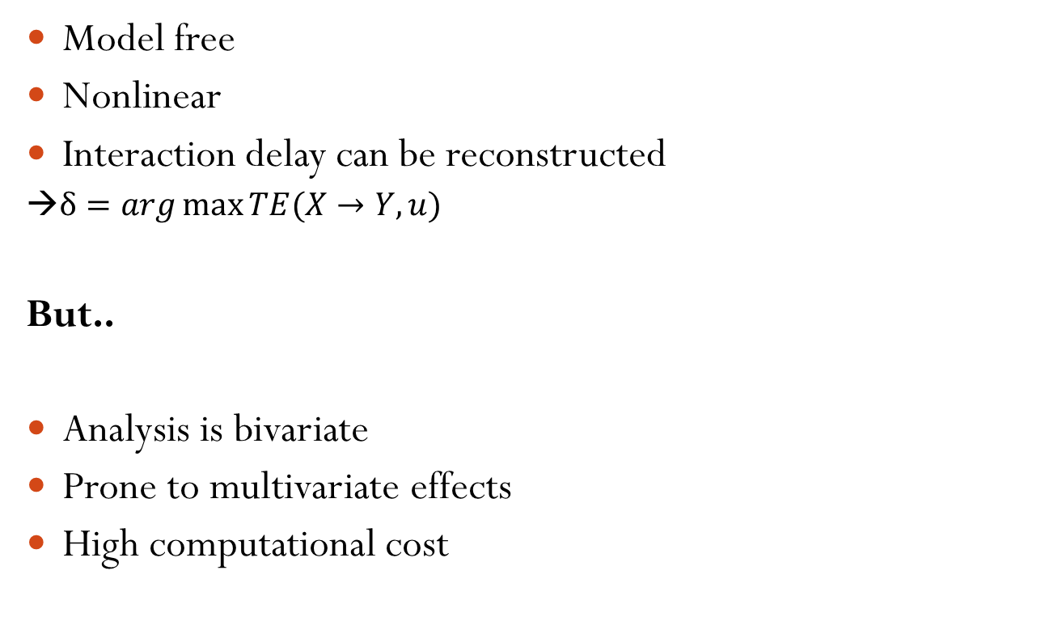
Advantages
Model free
Nonlinear
Interaction delay can be reconstructed
→$δ=\arg{\max{TE(X→Y,u)}}$
But..
Analysis is bivariate
Prone to multivariate effects
High computational cost
2
„Cascade“-Effect
1
3
2
„Common-Drive“-Effect
1
3

Slide 18
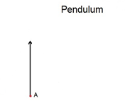
Transfer Entropy
Why States?
Wiener‘s formalism dictates optimal
selfprediction of the target timeseries
But:
Taking only one realization of a past variable
is insufficient for prediction!
?

Slide 19
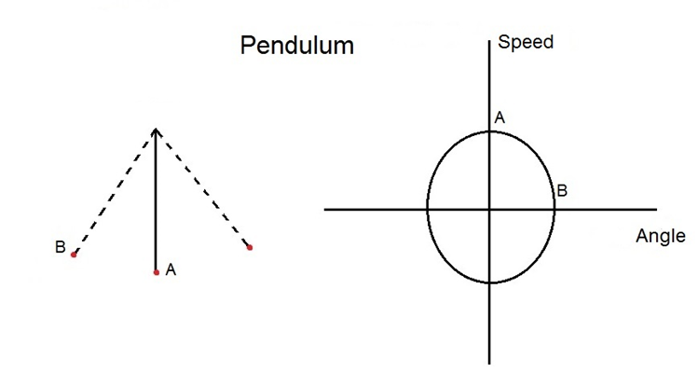
Transfer Entropy
Why States?
Wiener‘s formalism dictates optimal
selfprediction of the target timeseries
But:
Taking only one realization of a past variable
is insufficient for prediction!

Slide 20
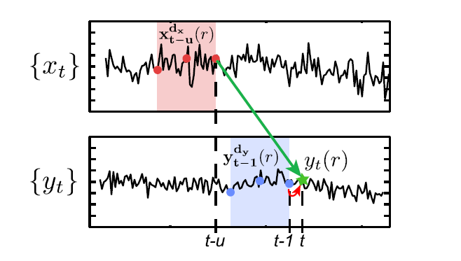
Example

Slide 21
Questions
What influence does common electrophysiological preprocessing have on the estimation of Transfer Entropy?
  What influence does…
    the filter type have?
    high-/lowpass filtering have?
    downsampling/decimate have?

Slide 22
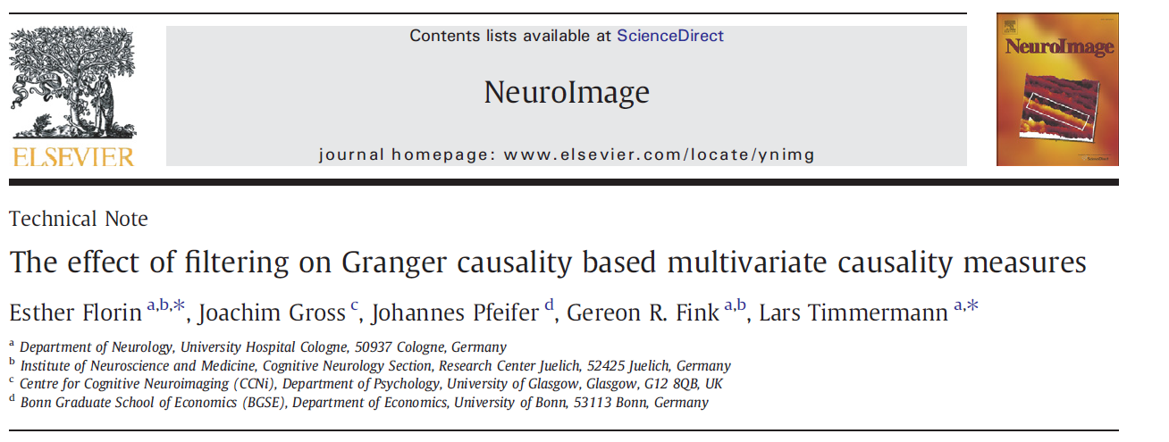
Previous Work

Slide 23
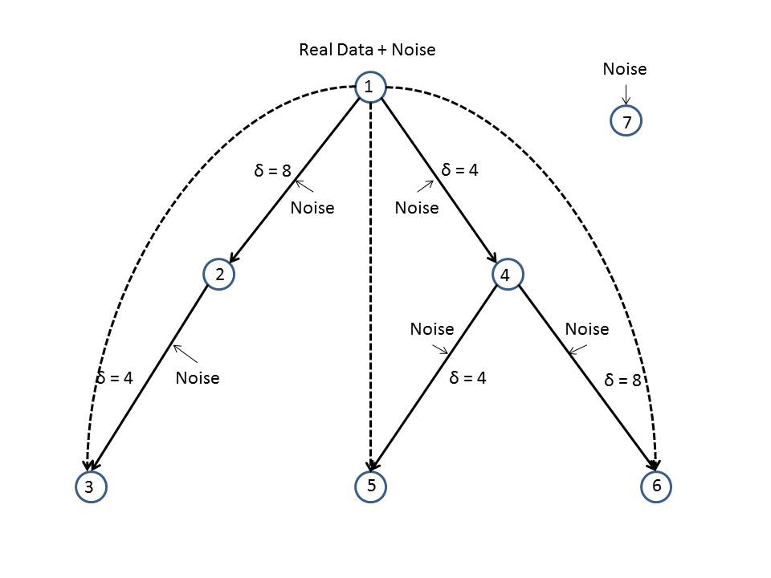
Kus-Model

Slide 24
Kus-Model

Slide 25
Analysis Plan

Slide 26
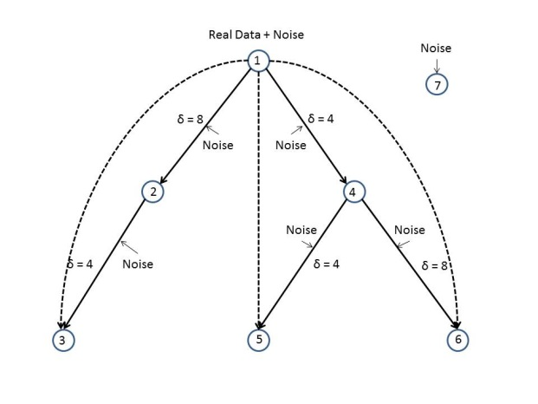
Control

Slide 27
Lowpass 160 Hz
Butterworth

Slide 28
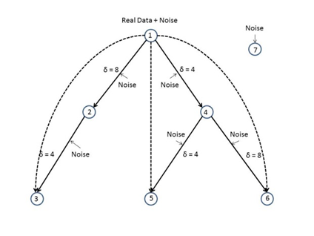
Lowpass 80 Hz
Butterworth

Slide 29
Highpass 2 Hz
Butterworth

Slide 30
Lowpass 160 Hz
Butterworth w/o Opt.

Slide 31
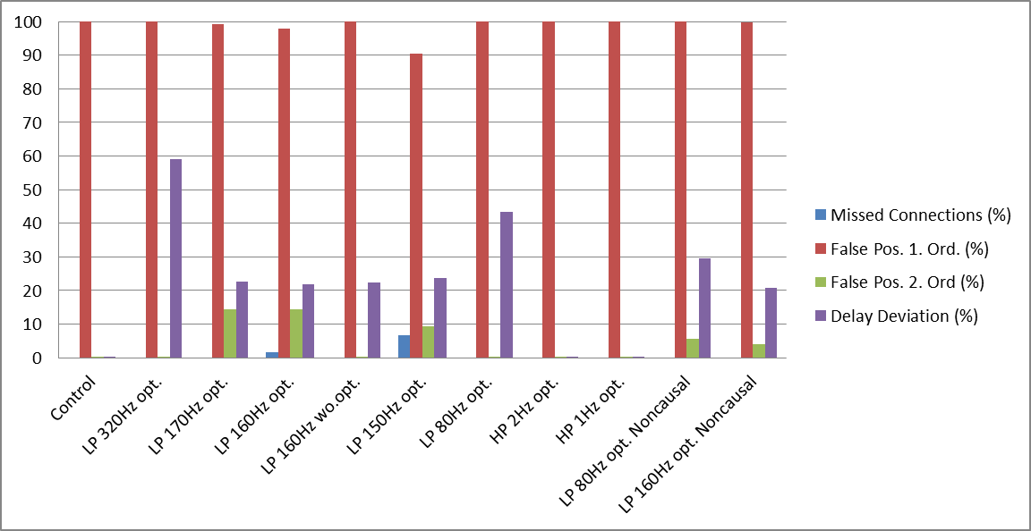
Results

Slide 32
Summary
Low-/Highpass Filter only has very small effect on TE estimation
Greatest Effect after approx. 160 Hz lowpass filtering
But..
Can be ameliorated by optimizing parameters before filtering
Influence of filtering on Interaction Delay Estimation seems to be nonlinear

Slide 33
Future Plans
Validation of Dimmer-Switch Model with TE (TP1-Data)
Causality between EMG and STN/ViM activity in tremordominant Parkinson Patients
Comparison of TE with Granger-Causality

Slide 34
Thank you for your attention!

